Slide 1
HAZARDOUS GAS DETECTION USING IoT
BALA VAISHNAVI K (811721001004)
FAHMITHA NASRIN S (811721001008) KEERTHANA S (811721001017) SANDHYA SHALINI S M (811721001035)
GUIDE NAME:
Mrs.S.PRABASRI M.E., ASSISTANT PROFESSOR DEPARTMENT OF AI

Slide 2

ABSTRACT
The Hazardous Gas Detection System using IOT integrates bizarre sensor Technology, data analysis and wireless communication to provide early detection of hazardous gases to all surroundings.The core components used are advanced gas sensor like MQ6.The project implies a significant step towards creating smarter, safer and more resilient environment through the integration of advanced technology in gas detection and monitoring.

Slide 3

INTRODUCTION
❏ Safeguarding lives and the environment.
❏ Epitomizes as vigilant guardian.
❏ Exemplifies a responsive shield.
❏ Act as sentinels.
❏ Provides a swift response.

Slide 4

LITERATURE SURVEY
S.NO | PAPER NAME | JOURNAL NAME | YEAR | PROS | CONS
I | Embedded System for Hazardous Gas Detection and Alerting | IJDPS | 2012 | Knowledge dissemination | Subscription cost
II | Gas Leakage Detection and Alerting System Using Ardunio UNO | IJCRT | 2023 | Safety enhancement | False Alarms
III | Mobile Detection and Alarming System For Hazardous Gases | MDPI | 2021 | Stay Updated | Time Consuming

Slide 5
S.NO | PAPER NAME | JOURNAL NAME | YEAR | PROS | CONS
IV | Detection of hazardous VOCs by metal oxide nanostructures - based gas sensors | Ceramic International | 2016 | Selectivity | Drift
V | Multi - sensing paradigm based urban air quality monitoring and hazardous gas source analyzing. | Safety science and resilience | 2021 | Data Fusion | Complexity
VI | Toxic gas detection and monitoring utilizing internet of things | International journal of civil engineering and technology | 2017 | Remote Monitoring | Data Privacy

Slide 6

S.NO | PAPER NAME | JOURNAL NAME | YEAR | PROS | CONS
VII | Harmful Gas Detection and Monitoring System in Industries using IOT | IJCRT | 2022 | Data Analysis | Maintenance Challenges
VIII | Gas Leakage Detection and Smart Alerting System using IOT | IJIRS | 2018 | Fast Response Time | Appliciation Limitation
IX | Hazardous Gas Detection system with an Alerting Mechanism | IJARIIE | 2023 | Timely Alerts | Technical Failures

Slide 7

EXISTING SYSTEM
❏ Sensor Technology : Utilizes various sensor types to detect and measure different types of gases.
❏ Fixed and Portable Systems : Includes both fixed installations in industrial settings and portable devices for personal safety.
❏ Alarm and Warning Systems : Triggers alarms upon detecting hazardous gas levels, to take necessary precautions.
❏ Wireless Connectivity : Some systems incorporate wireless technology for remote monitoring and control.

Slide 8

DRAWBACKS
❏ False Alarms
❏ Frequent Maintanence
❏ Limited Range
❏ Slow Response Time
❏ Regular Calibration is necessary
❏ Detection of limited gas types
❏ High cost
❏ Requires high Complexity
❏ Prone to Environmental factors
❏ Dependent on a continuous power supply

Slide 9

PROPOSED SYSTEM
❏ Integration with Building Management Systems (BMS) and SCADA
❏ Power supply and Redundancy
❏ Calibration and Maintenance
❏ Training and Documentation
❏ Data Logging and Storage

Slide 10
ADVANTAGES
Early Warning
Safety
Health Presentation
Process Amendment
Budget Friendly
Remote Monitoring

Slide 11
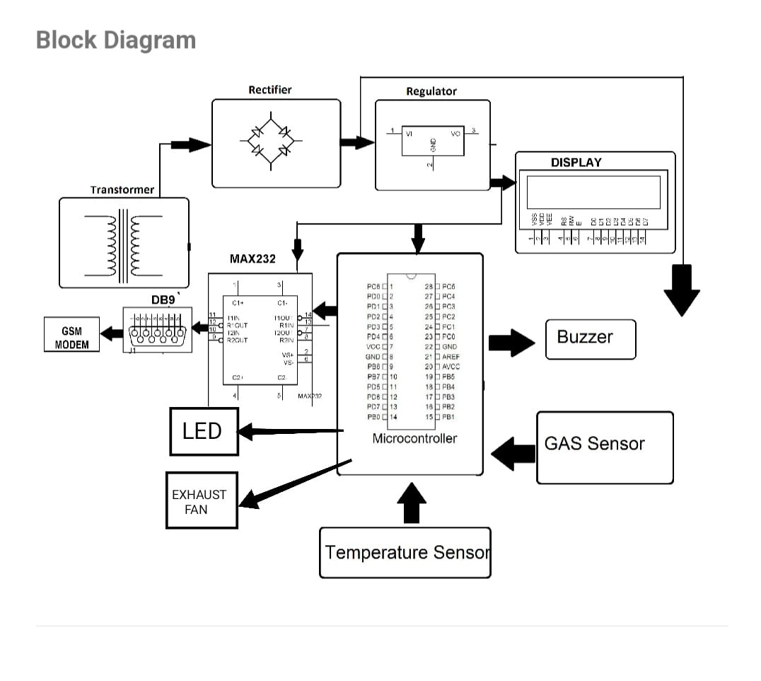

ARCHITECTURE
“

Slide 12

EXPLANATION
❏ Hazardous gas is detected by the sensor.
❏ The detection is notified by a red light signal.
❏ This signal automatically turns on the exhaust fan.
❏ A note of “Gas Detected” is displayed in the LCD Screen.
❏ Finally a message and a call alert is given to the client.

Slide 13

CONCLUSION
❏ Detecting hazardous gases is paramount for safety.
❏ Utilizing advanced sensors and technology, rapid identification of these gases is achievable.
❏ Early detection prevents potential disasters.
❏ Real-time monitoring systems provide continuous surveillance.
❏ Embracing efficient detection mechanisms stands as a cornerstone.

Slide 14

FUTURE WORK
❏ Alert Mechanism : Create a robust alert system to warn users in case of gas detection above safe levels.
❏ Integration : Develop hardware and software components for seamless integration of sensors,data preprocessing , and alert mechanisms.
❏ Power Efficiency : Optimize power consumption to extend battery life or minimize energy usage, especially for portable or remote deployment scenarios.

Slide 15

REFERENCES
V Ramya, B Palaniappan - International Journal of Distributed and …, 2012 - academia.edu
SH Cho, JM Suh, TH Eom, T Kim, HW Jang - Electronic Materials Letters, 2021 - Springer
KR Katole, V Bagade, B Bangade, A Soni… - International Journal of …, 2016 - academia.edu
A Somov, A Baranov, D Spirjakin - Sensors and Actuators A: Physical, 2014 - Elsevier
M JUALAYBA, K REGIO, H QUIOZON… - 2018 IEEE 10th …, 2018 - ieeexplore.ieee.org
MFR AL-okby, S Neubert, T Roddelkopf,K Thurow - Sensors, 2021 - mdpi.com
K Cen, T Yao, Q Wang, S Xiong - Chinese Journal of Chemical Engineering, 2018 - Elsevier
P Wang, W Chen, J Wang, F Zhou, J Hu… - Analytical …, 2021 - ACS Publications
MM Kotarski, JM Smulko - Fluctuation and Noise Letters, 2010 - World Scientific
E Hawe, C Fitzpatrick, P Chambers, G Dooly… - Sensors and Actuators A …, 2008 - Elsevier

Slide 16
SAMPLE CODE
#include <LiquidCrystal.h>
#include <SoftwareSerial.h> // Library for software serial communication
LiquidCrystal lcd(5, 6, 8, 9, 10, 11);
SoftwareSerial gsmSerial(7, 12); // RX, TX for the GSM module
int redled = 2;
int greenled = 3;
int buzzer = 4;
int sensor = A0;
int sensorThresh = 400;
String phoneNumber = "+1234567890";
// Replace with your phone number

Slide 17
void setup() {
pinMode(redled, OUTPUT);
pinMode(greenled, OUTPUT);
pinMode(buzzer, OUTPUT);
pinMode(sensor, INPUT);
Serial.begin(9600);
gsmSerial.begin(9600); // Initialize software serial for GSM module
lcd.begin(16, 2);
}
void sendSMS(String message) {
gsmSerial.println("AT+CMGF=1"); // Set the GSM module to text mode
delay(1000);
gsmSerial.print("AT+CMGS=\"");
gsmSerial.print(phoneNumber);
gsmSerial.println("\"");
delay(1000);
gsmSerial.println(message);
delay(1000);
gsmSerial.write(26); // End SMS command
delay(1000);
}

Slide 18
void makeCall() {
gsmSerial.println("ATD" + phoneNumber + ";"); // Call the specified number
delay(1000);
}
void loop() {
int analogValue = analogRead(sensor);
Serial.print(analogValue);
if (analogValue > sensorThresh)
{
digitalWrite(redled, HIGH);
digitalWrite(greenled, LOW);
tone(buzzer, 1000, 10000);
lcd.clear();
lcd.setCursor(0, 1);
lcd.print("ALERT");
delay(1000);
lcd.clear();
lcd.setCursor(0, 1);
lcd.print("EVACUATE");
delay(1000);

Slide 19
// Send SMS alert and make a call
sendSMS("Hazardous gas detected! Evacuate immediately.");
makeCall();
}
else
{
digitalWrite(greenled, HIGH);
digitalWrite(redled, LOW);
noTone(buzzer);
lcd.clear();
lcd.setCursor(0, 0);
lcd.print("SAFE");
delay(1000);
lcd.clear();
lcd.setCursor(0, 1);
lcd.print("ALL CLEAR");
delay(1000);
}
}

Slide 20
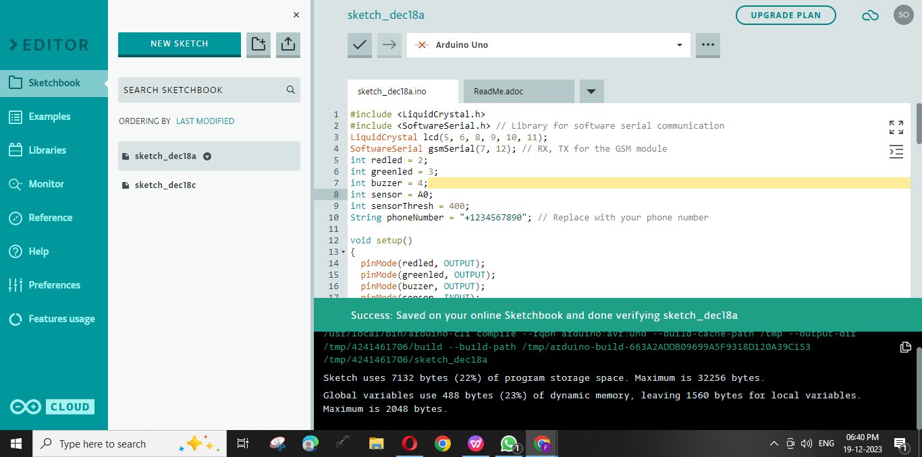
Sample Output

Slide 21





T H A N K Y O U !

